Slide 1
802 Project Summary
Maksuda Toma, Jo Charbonneau, Ryan Lalicker

Slide 2
Background & Context
The consumption of beef jerky has been linked to several illnesses and hospitalizations, most of which involving E. Coli or Salmonella. This has lead to several recalls of beef jerky which have been linked to these bacteria.
A study evaluated the effect of two different inoculation methods on Salmonella populations in beef jerky of different thicknesses. The variables involved were:
Salmonella counts
Inoculation methods (dry and wet)
Thickness (¼ inch and ⅛ inch)
Time (weeks 1-5)

Slide 3
Design
2x2 factorial design with two main factors:
Inoculation method (dry vs. wet)
Thickness (¼ & ⅛ inch)
Repeated measures taken over equal time intervals during Weeks 1-5

Slide 4
Model
𝑌_{𝑖𝑗𝑘𝑙} = 𝜇 + 𝛼_{𝑖} + 𝛽_{𝑗} + 𝜏_{𝑘} + (𝛼𝛽)_{𝑖𝑗} + (𝛼𝜏)_{𝑖𝑘} + (𝛽𝜏)_{𝑗𝑘} + (𝛼𝛽𝜏)_{𝑖𝑗𝑘} + 𝑢_{𝑙} + 𝑒_{𝑖𝑗𝑘l}
𝑌_{𝑖𝑗𝑘𝑙}: Salmonella Level
𝜇: overall mean
𝛼_{𝑖} :the effect of the 𝑖th inoculation method
𝛽_{𝑗}: the effect of the 𝑗th thickness level
𝜏_{𝑘}: r the effect of the 𝑘th week
(𝛼𝛽)_{𝑖j}: interaction effect of the 𝑖th inoculation method and the 𝑗th thickness level
(𝛼𝛽𝜏)_{𝑖𝑗𝑘}: three-way interaction between all fixed effects
𝑢_{𝑙}: random effect for batches
𝑒_{𝑖𝑗𝑘l} : residuals

Slide 5
Model
𝑌_{𝑖𝑗𝑘𝑙} = 𝜇 + 𝛼_{𝑖} + 𝛽_{𝑗} + 𝜏_{𝑘} + (𝛼𝛽)_{𝑖𝑗} + (𝛼𝜏)_{𝑖𝑘} + (𝛽𝜏)_{𝑗𝑘} + (𝛼𝛽𝜏)_{𝑖𝑗𝑘} + 𝑢_{𝑙} + 𝑒_{𝑖𝑗𝑘l}
𝑌_{𝑖𝑗𝑘𝑙}: Salmonella Level
𝜇: overall mean
𝛼_{𝑖} :the effect of the 𝑖th inoculation method
𝛽_{𝑗}: the effect of the 𝑗th thickness level
𝜏_{𝑘}: r the effect of the 𝑘th week
(𝛼𝛽)_{𝑖j}: interaction effect of the 𝑖th inoculation method and the 𝑗th thickness level
(𝛼𝛽𝜏)_{𝑖𝑗𝑘}: three-way interaction between all fixed effects
𝑢_{𝑙}: random effect for batches
𝑒_{𝑖𝑗𝑘l} : residuals

Slide 6
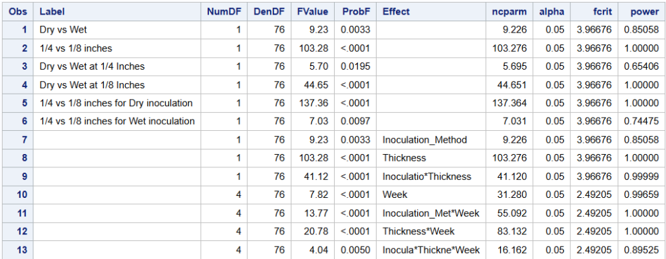
Power Analysis
Orthogonal Contrasts between variables:
Difference between inoculation methods (dry and wet)
Difference between thickness (¼ and ⅛ inch)
Generated dataset between five batches, identical response variables across batches. The dataset was then evaluated to determine the power.
Many terms show >80% power, and fixed effects were strong enough to then proceed

Slide 7
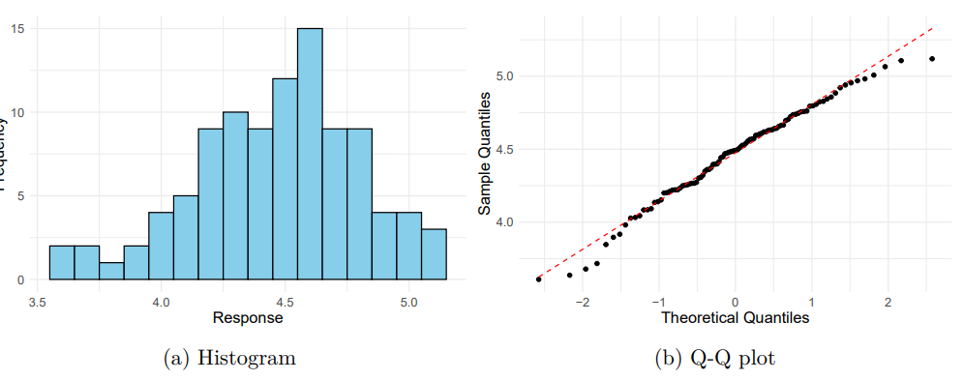
Simulated Data - Distribution of Response
Visualized to ensure a normal distribution:
Histogram indicates a slight skew, but not enough to say the distribution is not normal
Q-Q plot is indicative of a normal distribution

Slide 8
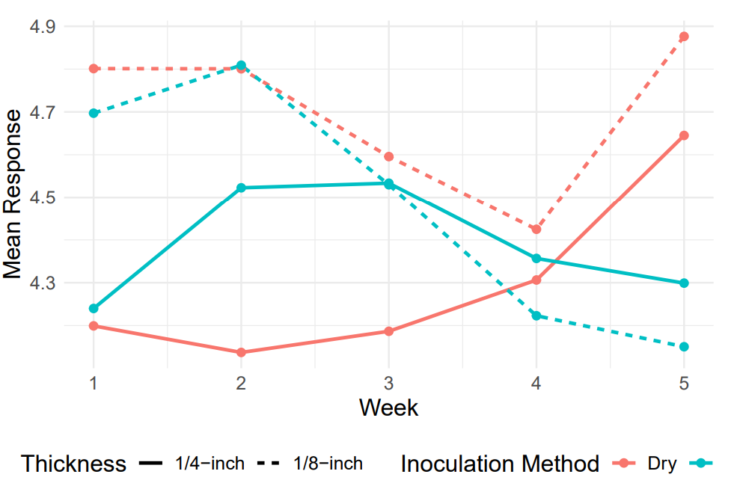
Simulated Data - Exploration
Wet inoculation method (blue lines) - mean response tends to decrease over time
Dry Inoculation (red lines) - mean response tends to incrase over time
⅛ inch thickness - responses were similar, diverging at the end of the experiment
¼ inch thickness - Showed more variation

Slide 9
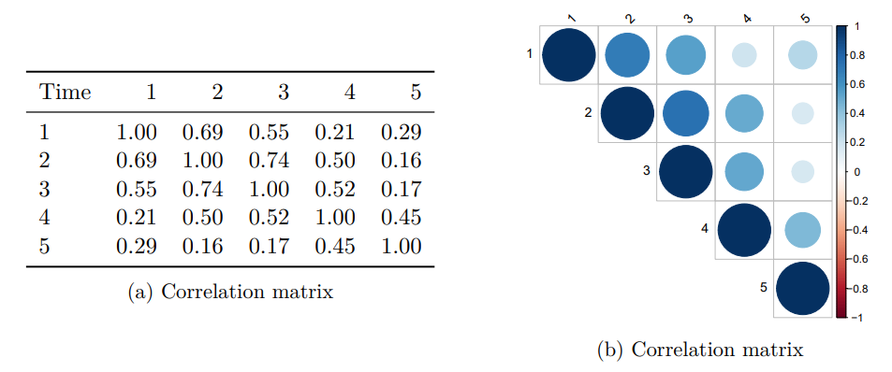
Correlation Over Time
Because this is a repeated measures experiment, we need to account for this variance by selecting a covariance structure.
Plan to use AR(p) structure with p = 1
Suited for equally spaced, ordered data over time
Strong correlations observed between adjacent weeks
Week 1 vs. Week 2 (r = 0.69)
Week 2 vs. Week 3 (r = 0.74)
Correlations weaken as time gap increases

Slide 10
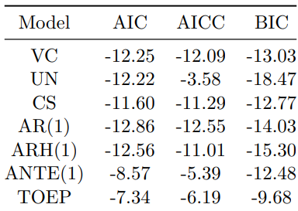
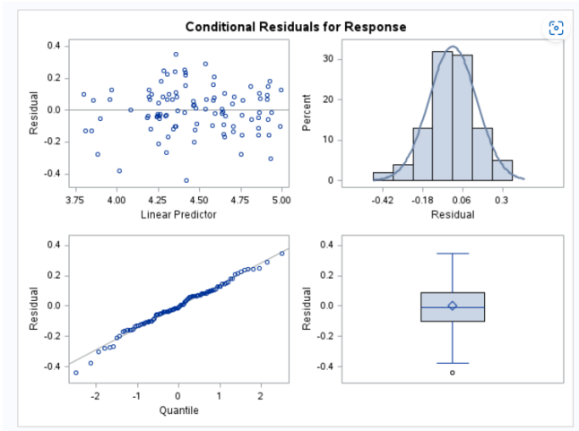
Model Results
While confident in AR(1), we also tested other covariance structures for comparison.
From the model comparison:
AR(1) structure is the best fit with the lowest AIC and AICC, and a respectable BIC score
In verifying model assumptions, we must check that residuals are normally distributed and homogeneous

